Slide 1
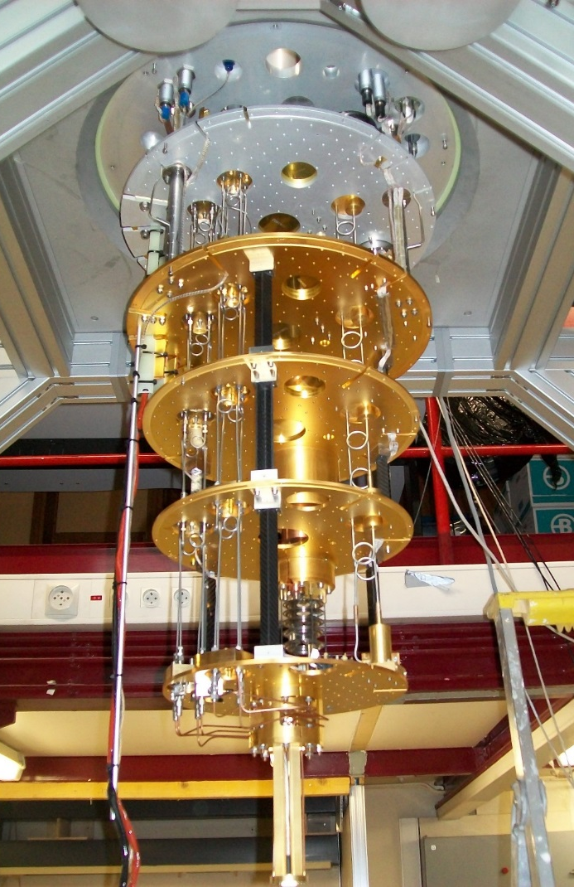
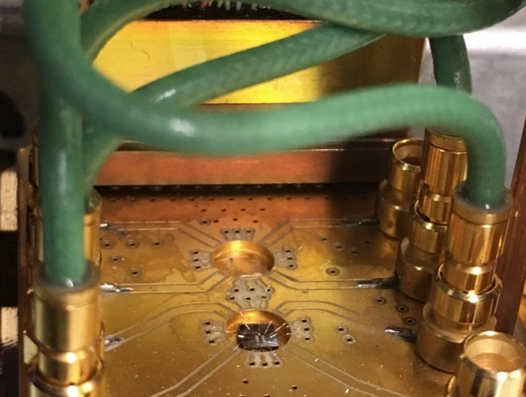


Electronique quantique dans les nanoconducteurs
Experiences LPENS
H. Bartolomei, M. Kumar, A. Marguerite, R. Bisognin,
J.M Berroir, E. Bocquillon,
B. Plaçais, G. Fève
300K
77K
4K
800 mK
Echantillons,
C2N Palaiseau
Y. Jin, Q. Dong, A. Cavanna,
U. Gennser
100 mK
Collaborations théoriques:
CPT Marseille, LPENS Lyon, LPS Orsay
$$T_{el}≈25mK$$

Slide 2






Optique électronique dans les conducteurs de Hall quantique
Interférométrie à 1 particule
mirror
mirror
V
Detector :
Source 1 :
beam –splitter
V_{G}
Source 2 :
Interféromètre de Mach-Zehnder
Y. Ji et al., Nature 422, 415 (2003)
Interférométrie à 2 particules
$$I_{t}$$
$$I_{r}(t′)$$
Detector 1 :
$$\left\langle I_{t}(t)I_{r}(t′)\right\rangle$$
Source 1 :
V
$$I_{t}(t)$$
$$\left\langle {∆I}_{t}∆I_{r}\right\rangle$$
Detector 2 :
$$I_{r}$$
Interféromètre Hanbury-Brown and Twiss
Source 2 :
M. Henny et al., Science 284, 296 (1999)

Slide 3
I Electrons dans le régime d’effet Hall quantique entier
II Anyons dans le régime d’effet Hall quantique fractionnaire

Slide 4
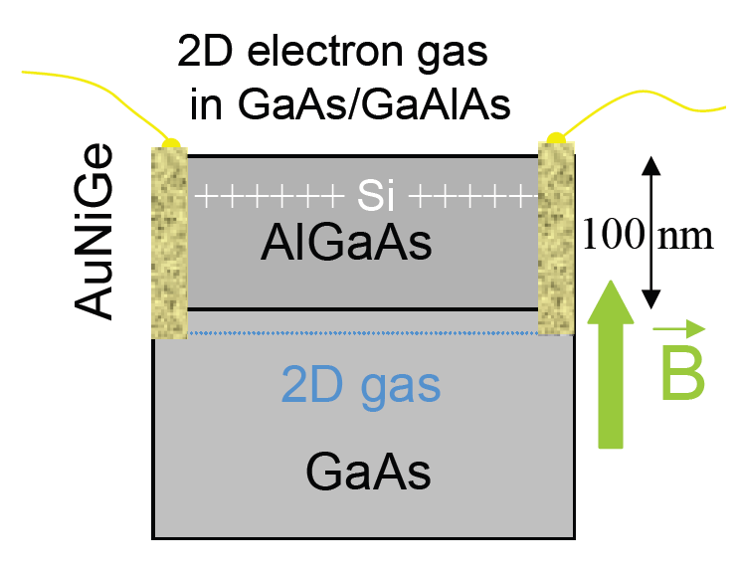
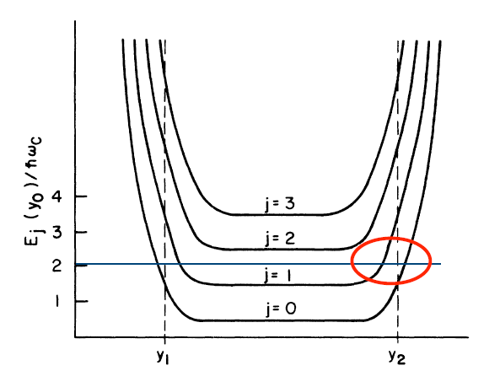






Matériaux 2D et fort champ magnétique: l’effet Hall quantique
z
Quantum well
width ~ 10 nnm
z
bound state
$$y_{2}$$
Niveaux de Landau
Compressible edges
$ν$ niveaux remplis
$$B$$
$$ℏω_{c}$$
Bulk insulating
Gap: ${ℏω}_{c}$
$$y_{1}$$

Slide 5
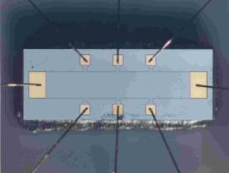
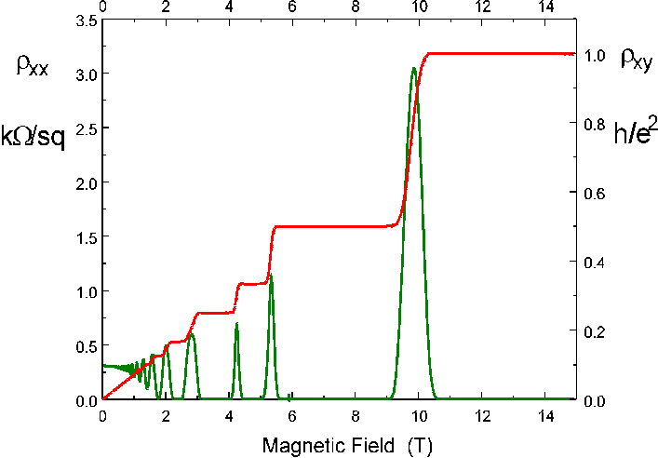




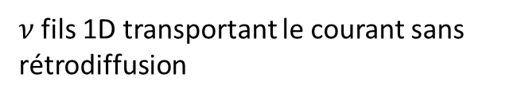






Matériaux 2D et fort champ magnétique: l’effet Hall quantique
$$V_{H}$$
z
Quantum well
width ~ 10 nnm
$$I$$
z
bound state
$$y_{2}$$
$$V_{L}$$
$$ρ_{xx}$$
$$R_{H}$$
$$R_{H}=\frac{h}{νe^{2}}$$
$$kΩ/sq$$
$$h/e^{2}$$
Effet Hall quantique:
$$G_{H}=v\frac{e^{2}}{h}$$
K. v. Klitzing, G. Dorda, and M. Pepper,
Phys. Rev. Lett. 45, 494 (1980).
Quantification robuste de la résistance Hall
$ν$fils 1D transportant le courant sans rétrodiffusion
$$R_{L}=0$$

Slide 6
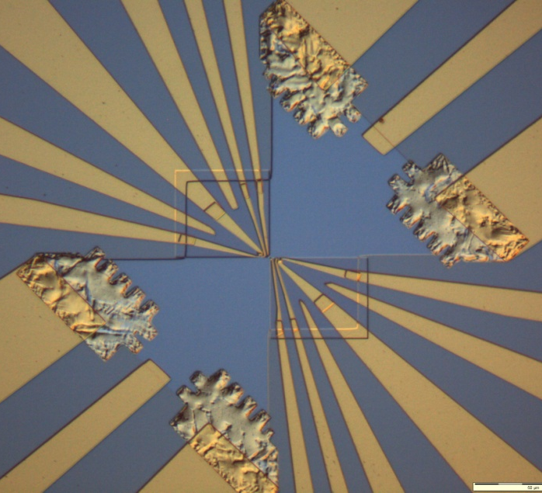
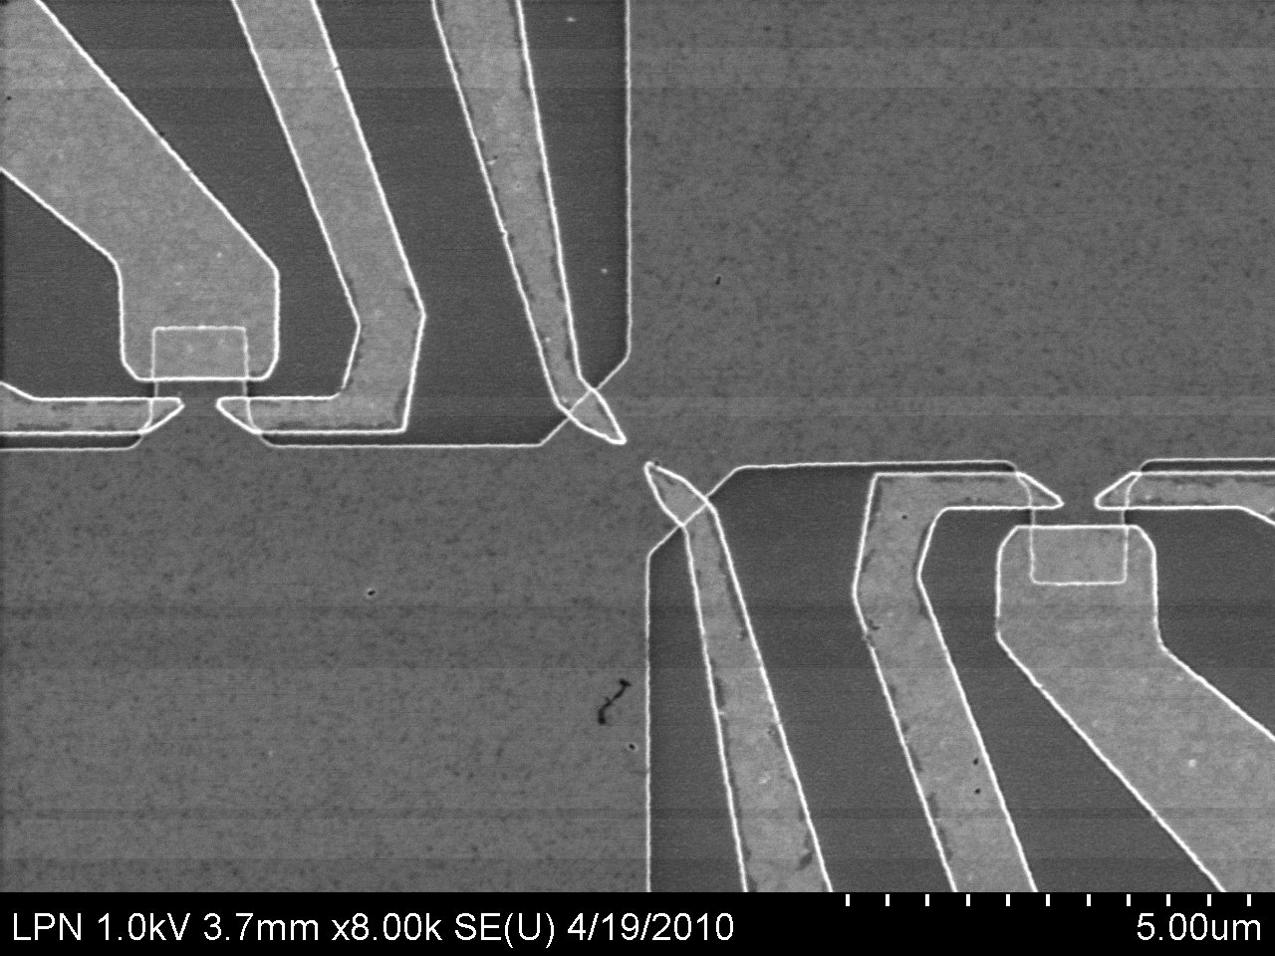
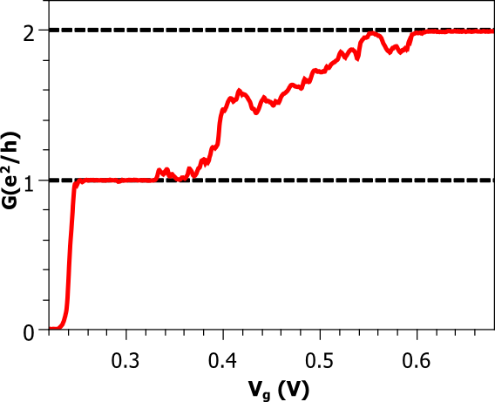




Le contact ponctuel quantique:
une lame semi-réfléchissante réglable
V_{g}
T
V
Example, $ν=2$
V_{g}
$$G=2\frac{e^{2}}{h}$$
Niveaux de Landau
$$G=1\frac{e^{2}}{h}$$
$$G=T\frac{e^{2}}{h}$$
Notes:
To obtain ballistic propagation, we use modulation doped heterostructures where two dimensionnal electron gas forms at the interface between two different semiconductors with different energy gaps and doping.
I won’t go into the details of the formation of this gaz but simply remember you that due to the spatial separation between the electron and the impurities they come from, this gaz can present very high mobility with mean free pathes which can be as high as a few tens of microns at low temperature.

Slide 7
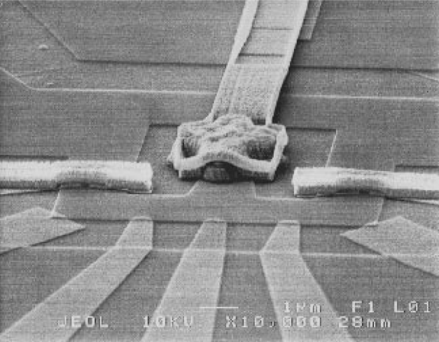
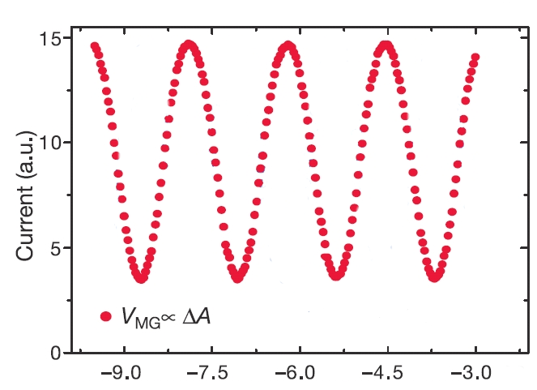
Un interféromètre de Mach-Zehnder électronique
Gaz 2D
I
V
Y. Ji et al., Nature 422, 415 (2003)
V_{G}
I
V_{G(mV)}

Slide 8
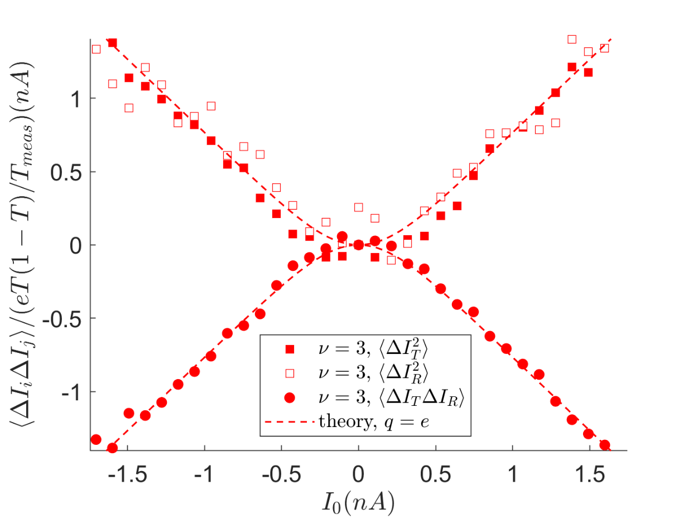







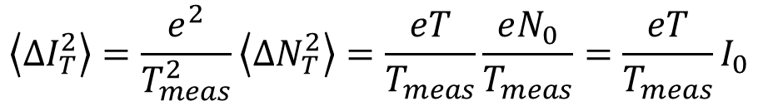






Interféromètre à deux particules:
mesures de bruit
$$\left\langle ∆I_{T}∆I_{R}\right\rangle$$
T<<1: processus de Poisson
$$I_{R}$$
$$\left\langle ∆N_{T}^{2}\right\rangle =\left\langle N_{T}\right\rangle =TN_{0}$$
R
$$I_{T}$$
$$h/eV$$
$$\left\langle ∆I_{T}^{2}\right\rangle =\frac{e^{2}}{T_{meas}^{2}}\left\langle ∆N_{T}^{2}\right\rangle =\frac{eT}{T_{meas}}\frac{eN_{0}}{T_{meas}}=\frac{eT}{T_{meas}}I_{0}$$
T
$$I_{0}$$
$$I_{T}$$
$$\left\langle ∆I_{T}^{2}\right\rangle +\left\langle ∆I_{R}^{2}\right\rangle +2\left\langle ∆I_{T}∆I_{R}\right\rangle =\left\langle ∆I_{0}^{2}\right\rangle =0$$
$$\left\langle ∆I_{T}∆I_{R}\right\rangle =−\left\langle ∆I_{T}^{2}\right\rangle$$
$$I_{R}$$
T
$$V$$
$$q$$
$$I_{0}$$
$$I_{T}$$

Slide 9
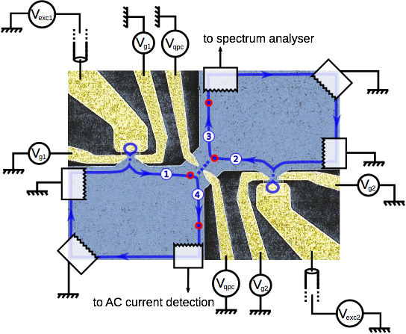
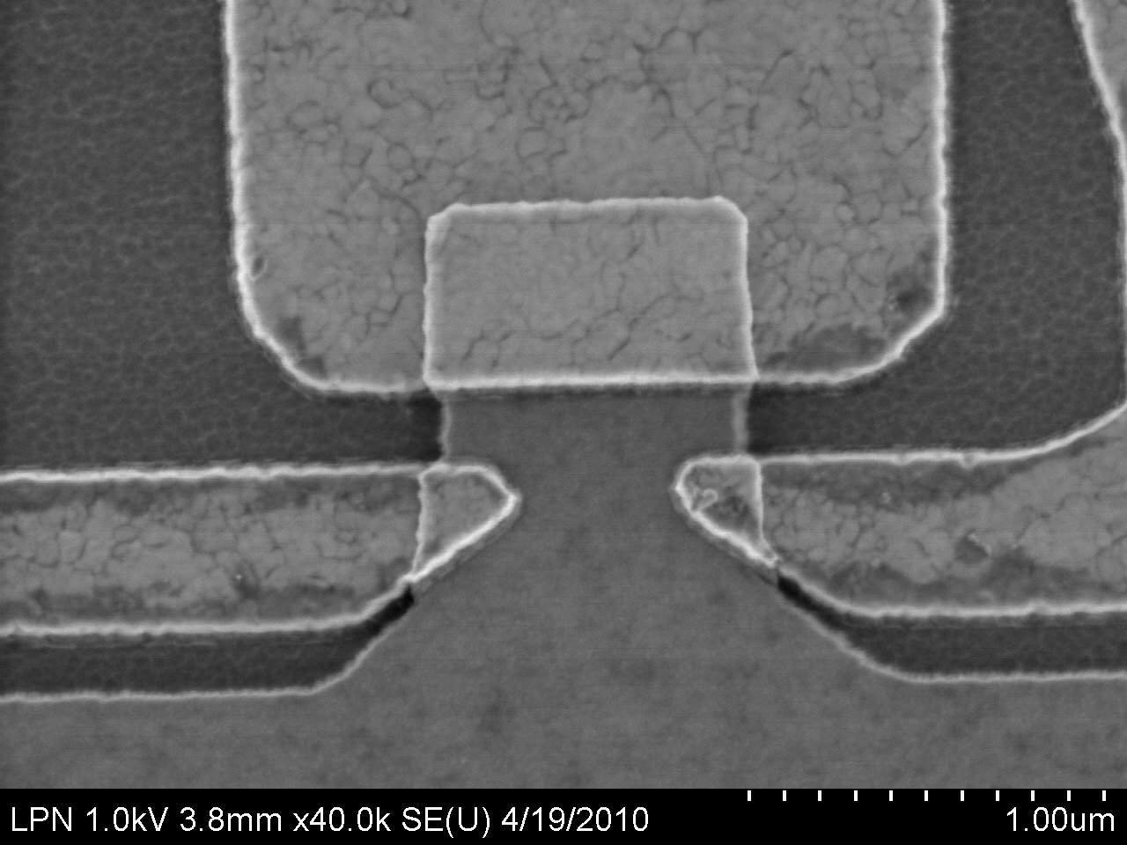

Interféromètre à deux particules:
l’experience HOM électronique
3
1
4
Source 1
Source 1
2
Delay
Source 2
Source 2
Boite quantique
=atome artificiel
Photons :
C. Hong et al., PRL 59(18), 2044 (1987)

Slide 10
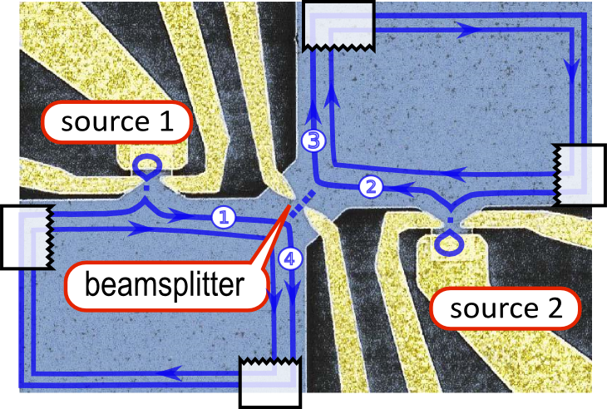







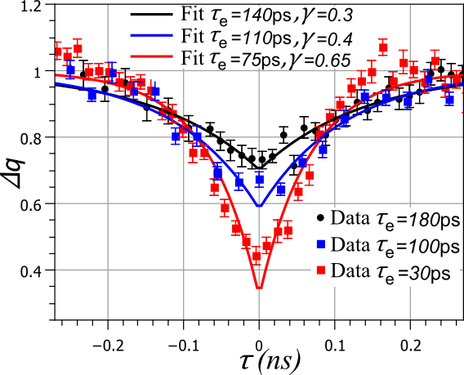




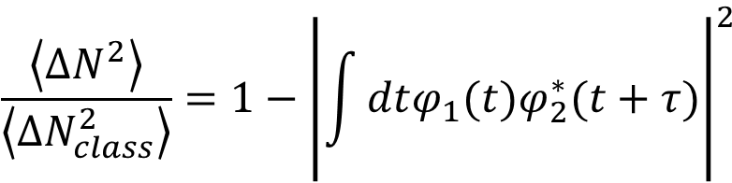
Noise measurements and two electron interferences
1
2
1
2
3
4
3
4
1
2
3
4
$$\frac{\left\langle {ΔN}^{2}\right\rangle }{\left\langle {ΔN}_{class}^{2}\right\rangle }=1−{\left|\int{dtφ_{1}(t)φ_{2}^{∗}(t+τ)}\right|}^{2}$$
Fluctuations classiques
(bruit de partition)
Recouvrement entre états
S. Ol'khovskaya et al., PRL 101, 166802, (2008).
Signe – pour les fermions
E. Bocquillon et al., Science 339, 1054 (2013).
A. Marguerite et al., PRB 94, 115311 (2016).

Slide 11

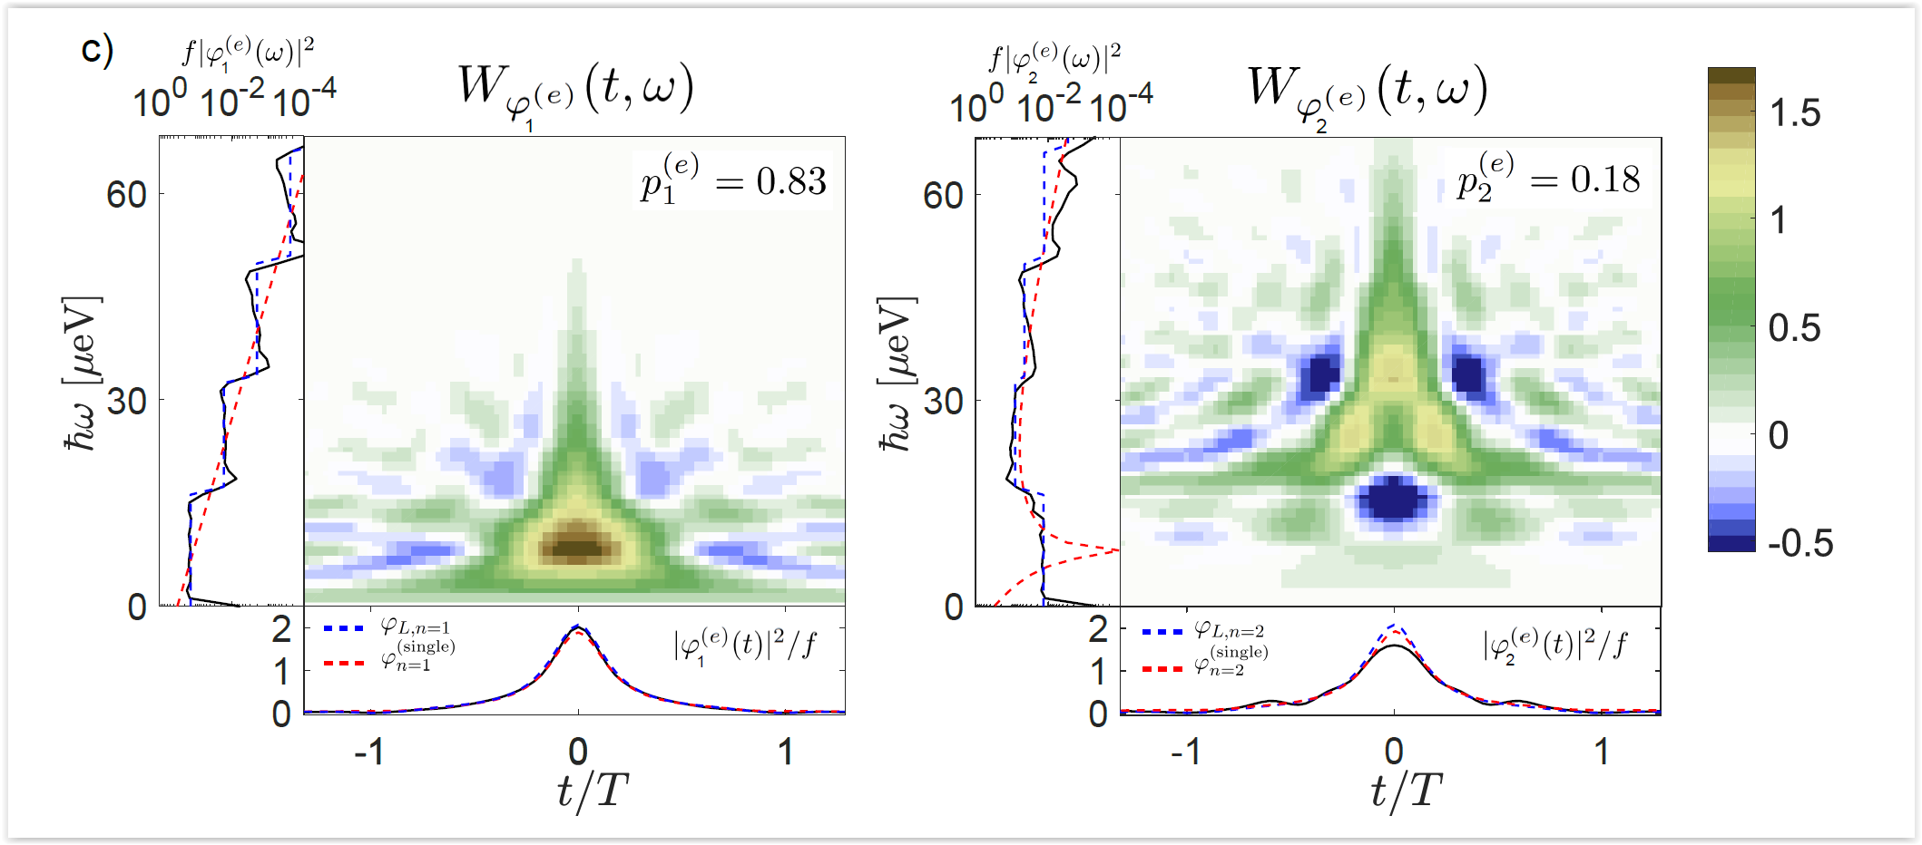




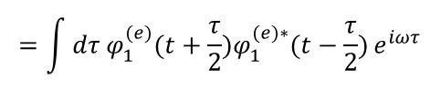
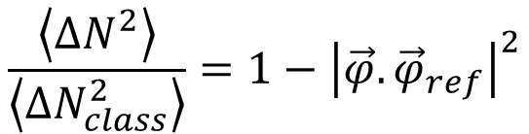
Extraction des fonctions d’onde d’électrons
$$\frac{\left\langle {ΔN}^{2}\right\rangle }{\left\langle {ΔN}_{class}^{2}\right\rangle }=1−{\left|\vec{φ}.{\vec{φ}}_{ref}\right|}^{2}$$
état inconnu:
Base d’états.
Mélange:
$$φ_{1}\left(t\right),$$
$$P_{1}=0.8$$
$φ_{2}(t)$,
$$P_{2}=0.2$$
$$=\int{dτ φ_{1}^{(e)}(t+\frac{τ}{2})φ_{1}^{(e)∗}(t−\frac{τ}{2})}e^{iωτ}$$
T. Jullien et al., Nature 514, 603–607 (2014)
R Bisognin, A Marguerite, B Roussel, et al. Nature communications 10, 1-12 (2019)

Slide 12
I Electrons dans le régime d’effet Hall quantique entier
II Anyons dans le régime d’effet Hall quantique fractionnaire

Slide 13
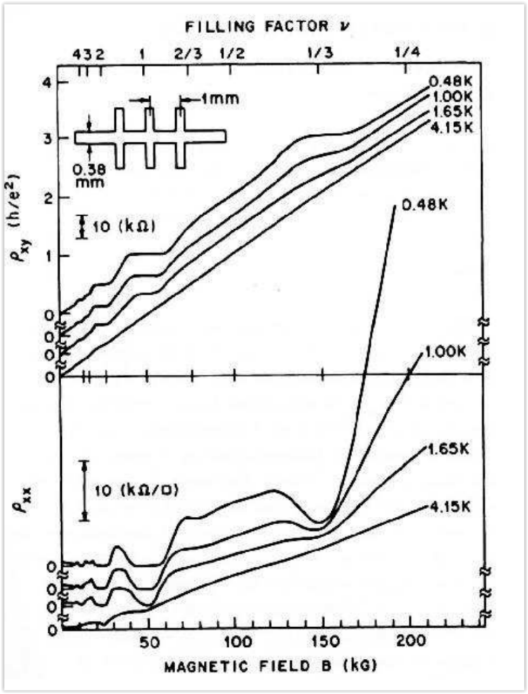




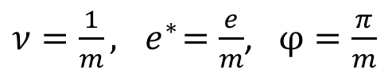




L’effet Hall quantique fractionnaire
High field,
$ν$<1
$$N=2$$
$$ℏω_{c}$$
$$N=1$$
$$N=0$$
Premier niveau de Landau partiellement rempli
La seule échelle d’énergie restante est l’interaction de Coulomb
$$H=E_{c}$$
On retrouve un système isolant au cœur (incompressible) pour des remplissages spécifiques:
$$ν=\frac{1}{m} (\frac{1}{3},..)$$
R. Laughlin, Phys. Rev. Lett.50, 1395 (1983).
Résistance/ conductance Hall quantifiée
$$G_{H}=\frac{1}{m}\frac{e^{2}}{h}$$
Excitations élémentaires= anyons: charge et statistique fractionnaires
D.C. Tsui, H.L. Stormer, and A.C. Gossard, Phys. Rev. Lett.48, 1559 (1982).
$ν=\frac{1}{m}, { e}^{∗}=\frac{e}{m}$, $φ=\frac{π}{m}$
Halperin, PRL 52 1583 (1984)

Slide 14
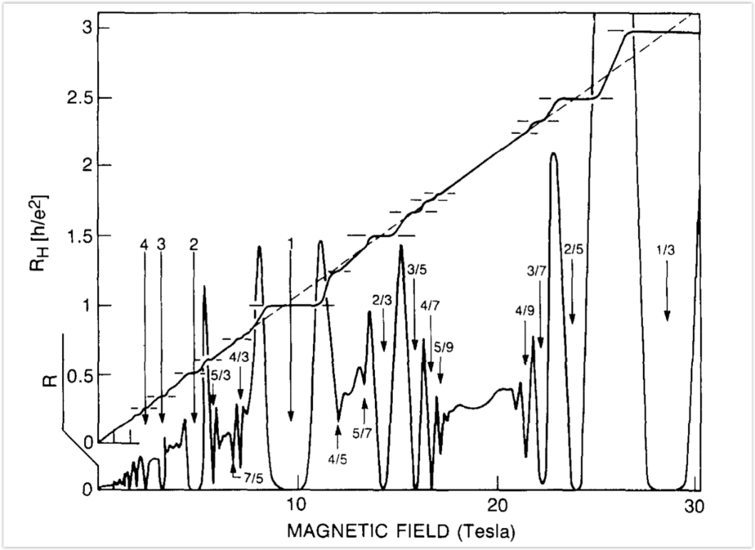
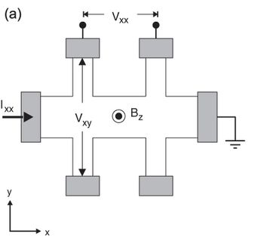

L’effet Hall quantique fractionnaire
L
$$T_{el}=25mK$$
H
electrons
anyons
H.L. Stormer, Physica B 177, 401 (1992).

Slide 15
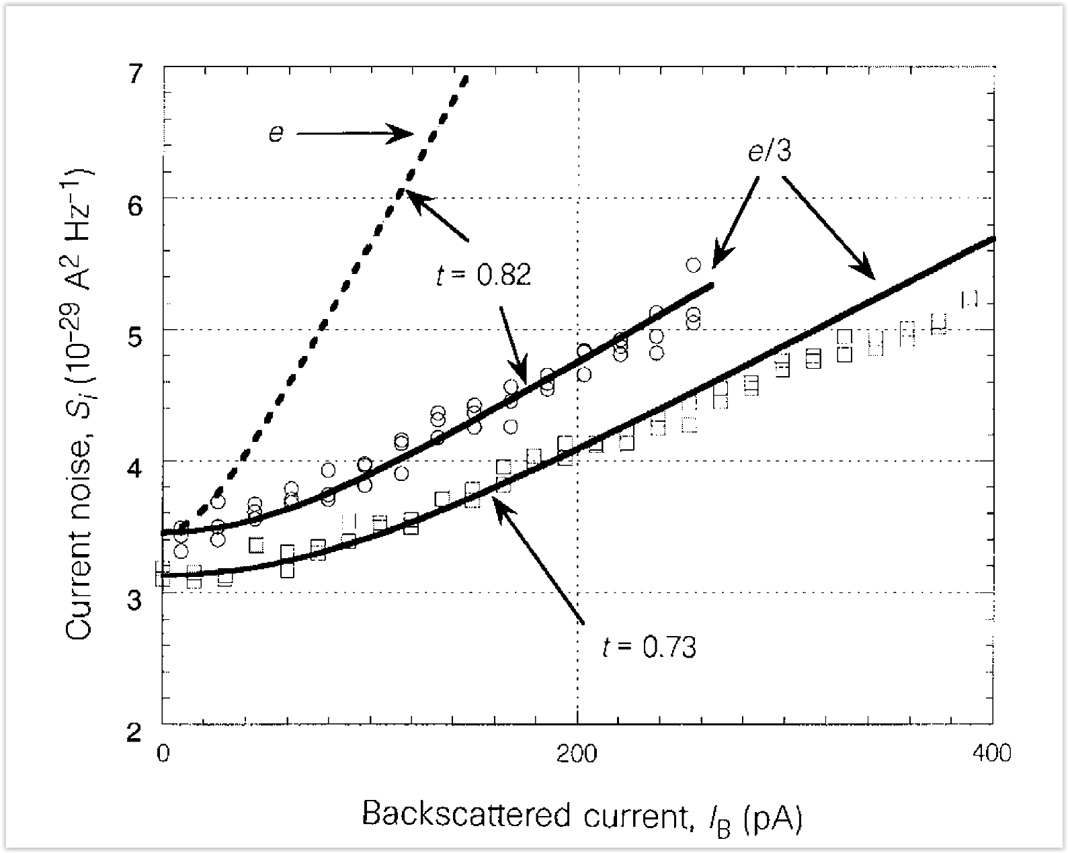
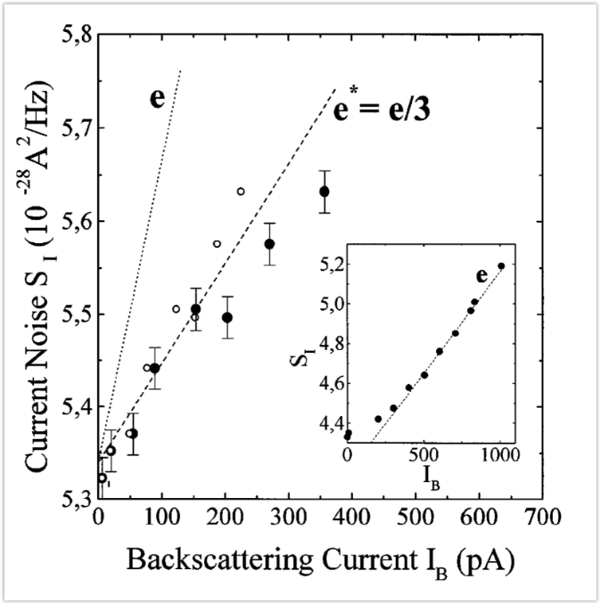

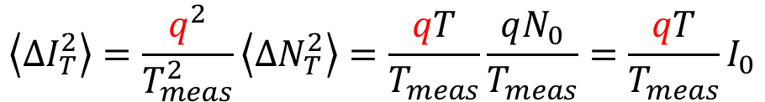






Bruit et charges fractionnaires, ν=1/3
$$I_{4}$$
T<<1: processus de Poisson
$$\left\langle ∆N_{T}^{2}\right\rangle =\left\langle N_{T}\right\rangle =TN_{0}$$
T
$$V$$
$$\left\langle ∆I_{T}^{2}\right\rangle =\frac{q^{2}}{T_{meas}^{2}}\left\langle ∆N_{T}^{2}\right\rangle =\frac{qT}{T_{meas}}\frac{qN_{0}}{T_{meas}}=\frac{qT}{T_{meas}}I_{0}$$
$$I_{0}$$
$$q$$
$$I_{3}$$
Fractional case:
$${ν=1/3, q=e/3}_{}^{}$$
R. de Picciotto et al., Nature 389, 162 (1997).
L. Saminadayar et al., Phys. Rev. Lett. 79, 2526 (1997).

Slide 16
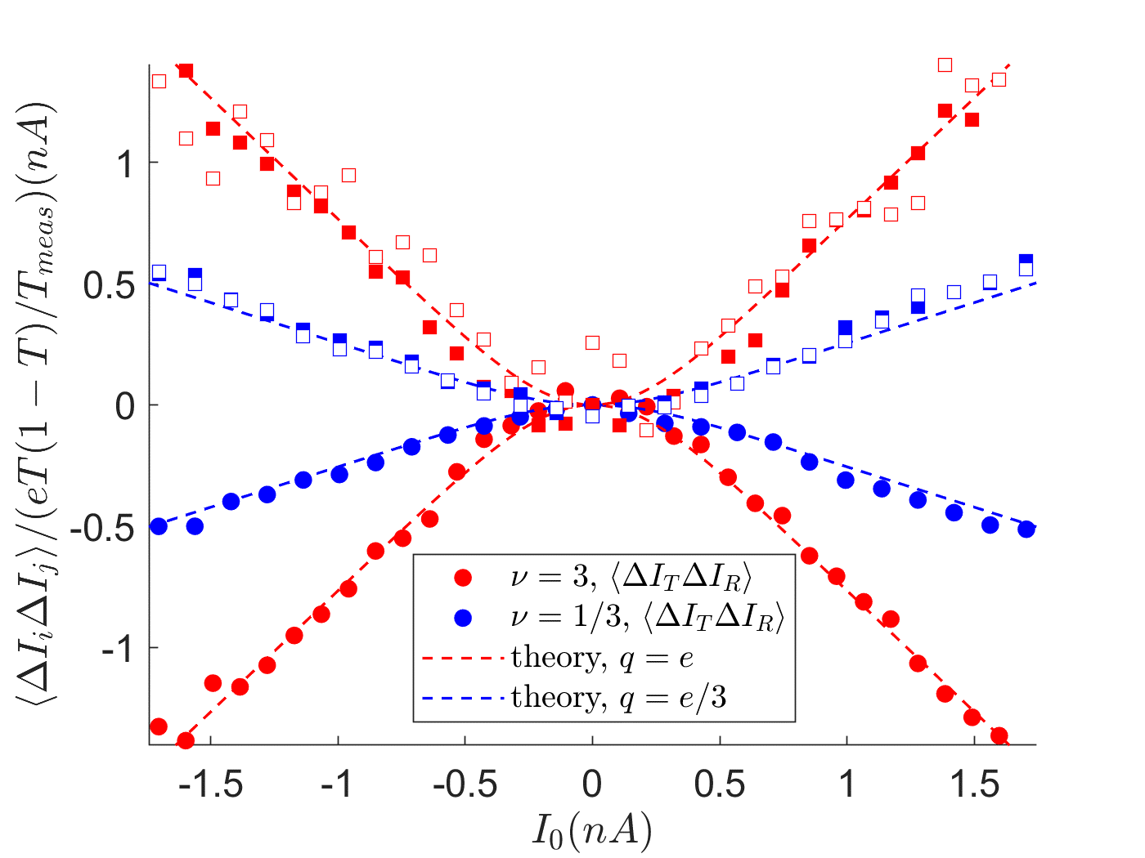


Bruit et charges fractionnaires, ν=1/3
$$I_{4}$$
T<<1: processus de Poisson
$$\left\langle ∆N_{T}^{2}\right\rangle =\left\langle N_{T}\right\rangle =TN_{0}$$
T
$$V$$
$$\left\langle ∆I_{T}^{2}\right\rangle =\frac{q^{2}}{T_{meas}^{2}}\left\langle ∆N_{T}^{2}\right\rangle =\frac{qT}{T_{meas}}\frac{qN_{0}}{T_{meas}}=\frac{qT}{T_{meas}}I_{0}$$
$$I_{0}$$
$$q$$
$$I_{3}$$
$$q=e$$
$$q=e/3$$

Slide 17
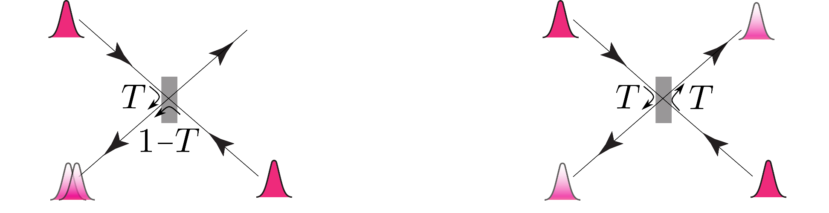














Collisionneurs : groupement et dégroupement
$$1$$
$$3$$
$$1$$
$$3$$
$$∆I_{3}<0$$
$$∆I_{3}=0$$
$$∆I_{4}>0$$
$$4$$
$$2$$
$$4$$
$$2$$
$$∆I_{4}=0$$
Groupement
Dégroupement
$\left\langle ∆I_{3}∆I_{4}\right\rangle <0$
$\left\langle ∆I_{3}∆I_{4}\right\rangle =0$

Slide 18


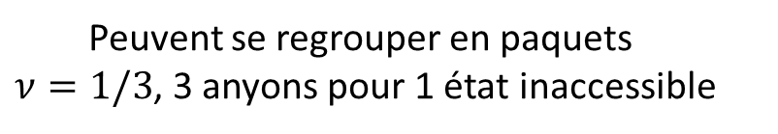
Collisionneurs : groupement et dégroupement
$$1$$
$$3$$
$$1$$
$$3$$
$$∆I_{3}<0$$
$$∆I_{3}=0$$
$$∆I_{4}>0$$
$$4$$
$$2$$
$$4$$
$$2$$
$$∆I_{4}=0$$
Groupement
Dégroupement
$\left\langle ∆I_{3}∆I_{4}\right\rangle <0$
$\left\langle ∆I_{3}∆I_{4}\right\rangle =0$
Anyons
Electrons: fermions
$φ=π/3$ ($ν=1/3)$
$$φ=π$$
Peuvent se regrouper en paquets
$ν=1/3$, 3 anyons pour 1 état inaccessible
Dégroupement complet Principe d’exclusion de Pauli
Haldane PRL 67 937 (1991)

Slide 19
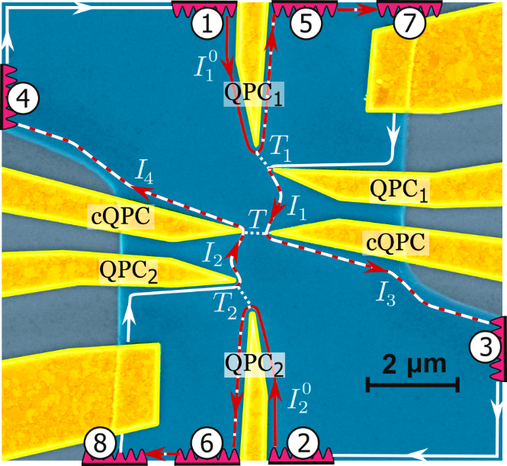





Le collisionneur à anyons
Particules émises dans les bras d’entrées
avec une probabilité:
$$T_{1}=T_{2}=T_{S}$$
Courant total
$I_{+}=I_{1}$ +${ I}_{2}$
Différence de courant
$$I_{−}=I_{1}−I_{2}=0$$
Pseudo-facteur de Fano
$$\left\langle ∆I_{3}∆I_{4}\right\rangle =P 2qT(1−T)I_{+}/T_{meas}$$
Prédictions:
Electrons (fermions), $P=0$
Anyons ($υ=1/3$), $P=−2 (for φ=\frac{π}{3})$
B. Rosenow et al., PRL 116, 156802 (2016)

Slide 20
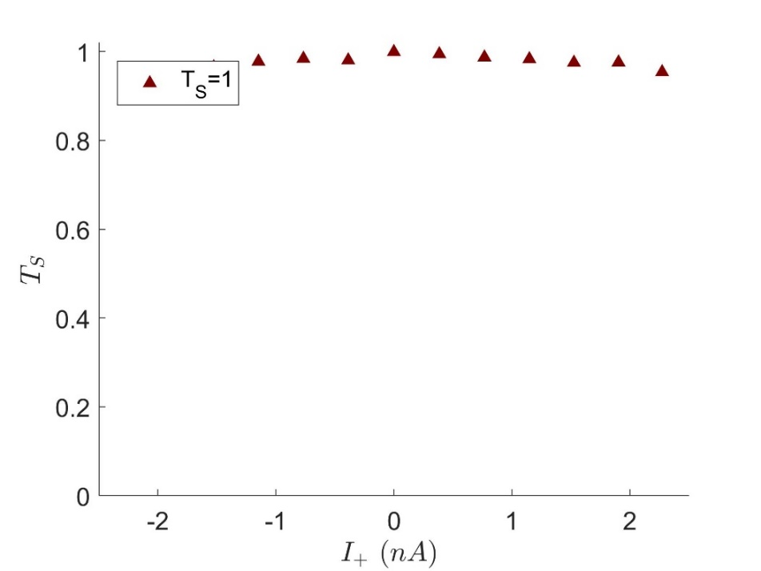
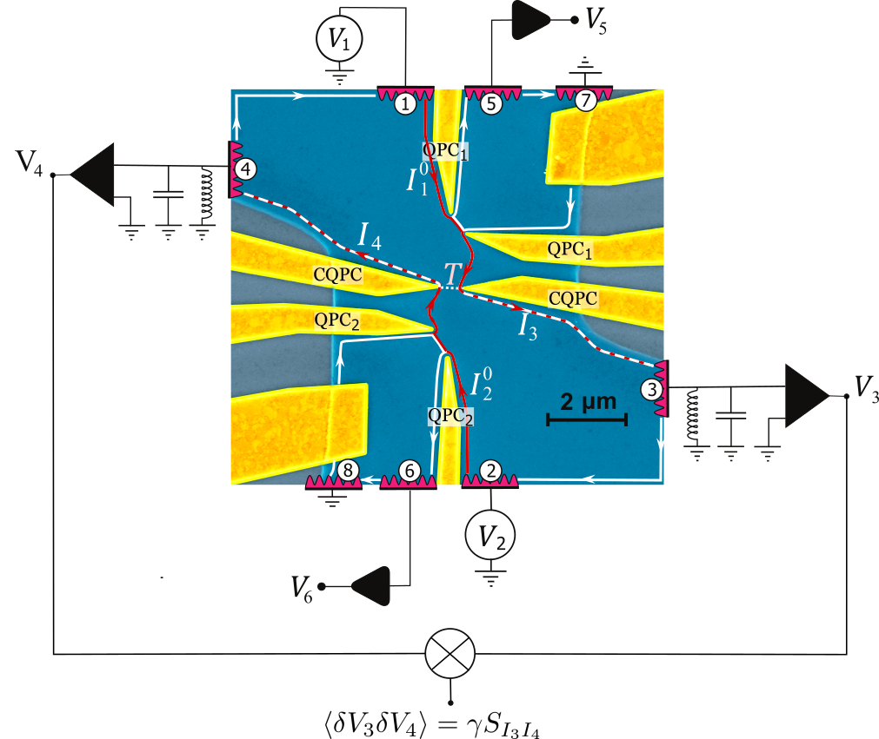

Collisions d’électrons, $ν=2$
Cas entier:
$${ν=2, {T=0.4, T}_{S}=1}_{}^{}$$
H. Bartolomei, M. Kumar et al., Science 368 173 (2020)

Slide 21
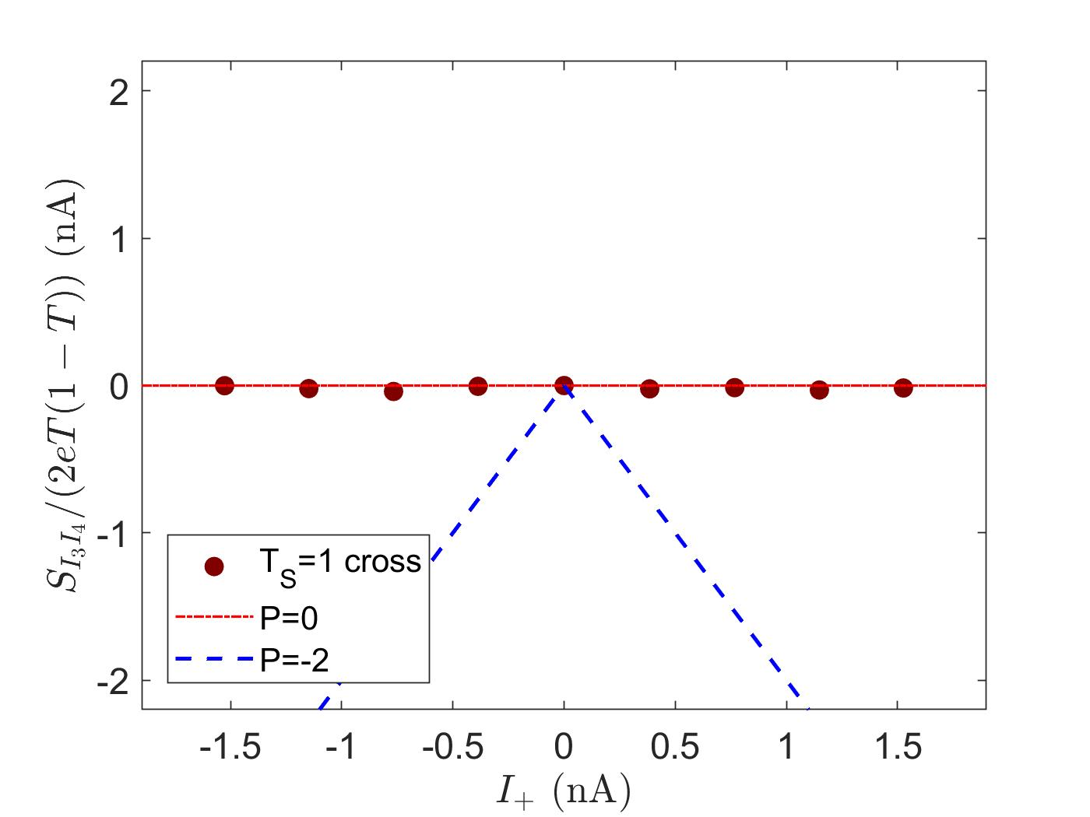


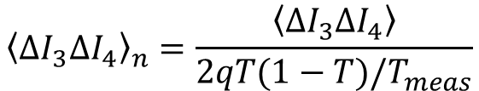

Collisions d’électrons, $ν=2$
Cas entier:
$${ν=2,{T=0.4, T}_{S}=1}_{}^{}$$
$${\left\langle ∆I_{3}∆I_{4}\right\rangle }_{n} (nA)$$
$${\left\langle ∆I_{3}∆I_{4}\right\rangle }_{n}=\frac{\left\langle ∆I_{3}∆I_{4}\right\rangle }{2qT(1−T)/T_{meas}}$$
$${\left\langle ∆I_{3}∆I_{4}\right\rangle }_{n}=PI_{+}$$
H. Bartolomei, M. Kumar et al., Science 368 173 (2020)

Slide 22
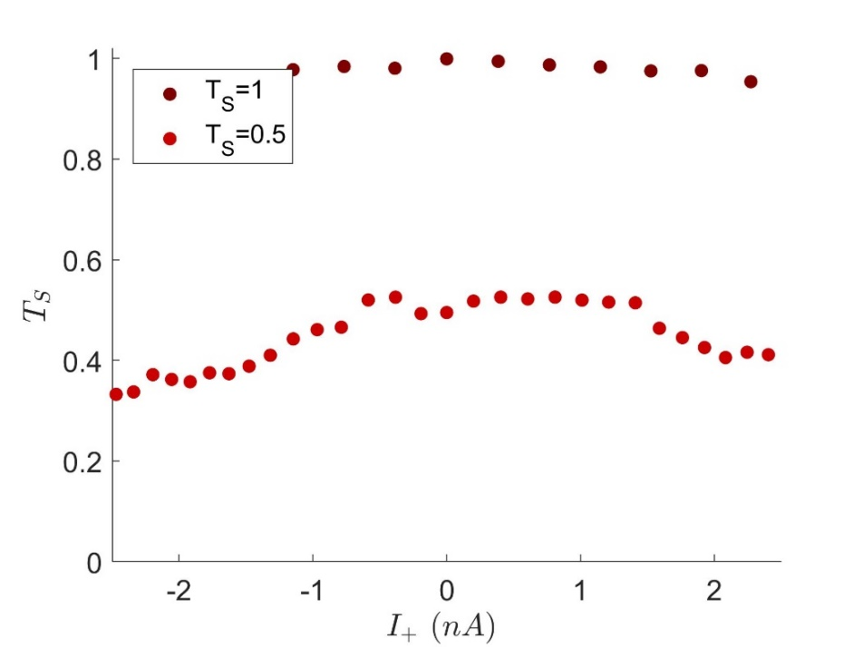
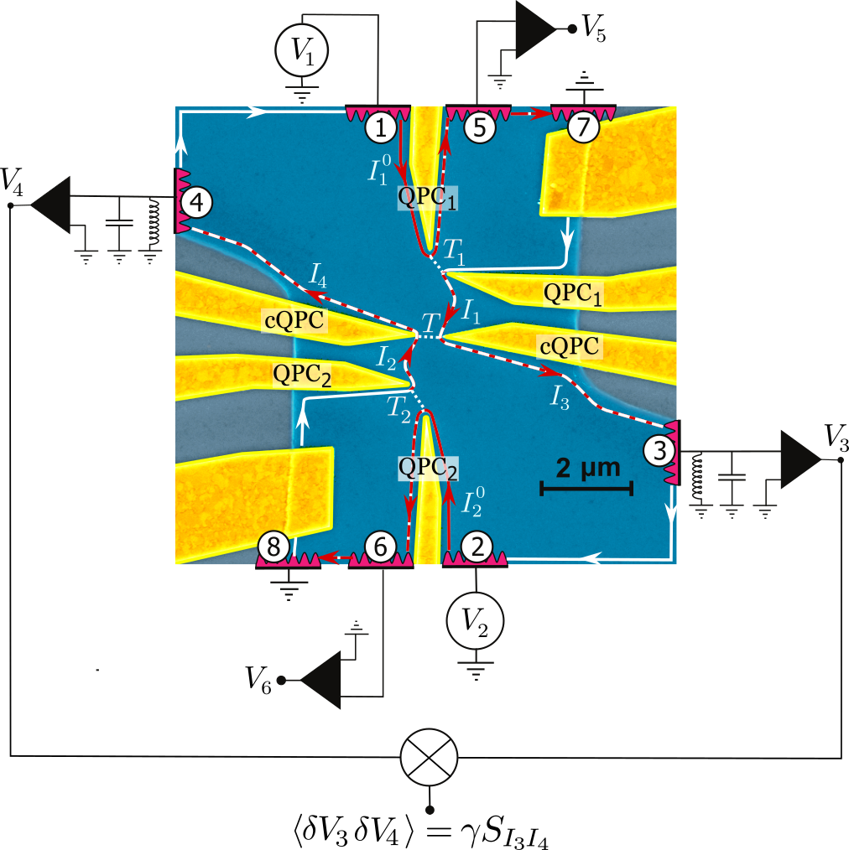

Collisions d’électrons, $ν=2$
Cas entier:
$${ν=2,{T=0.4, T}_{S}=0.5}_{}^{}$$
H. Bartolomei, M. Kumar et al., Science 368 173 (2020)

Slide 23
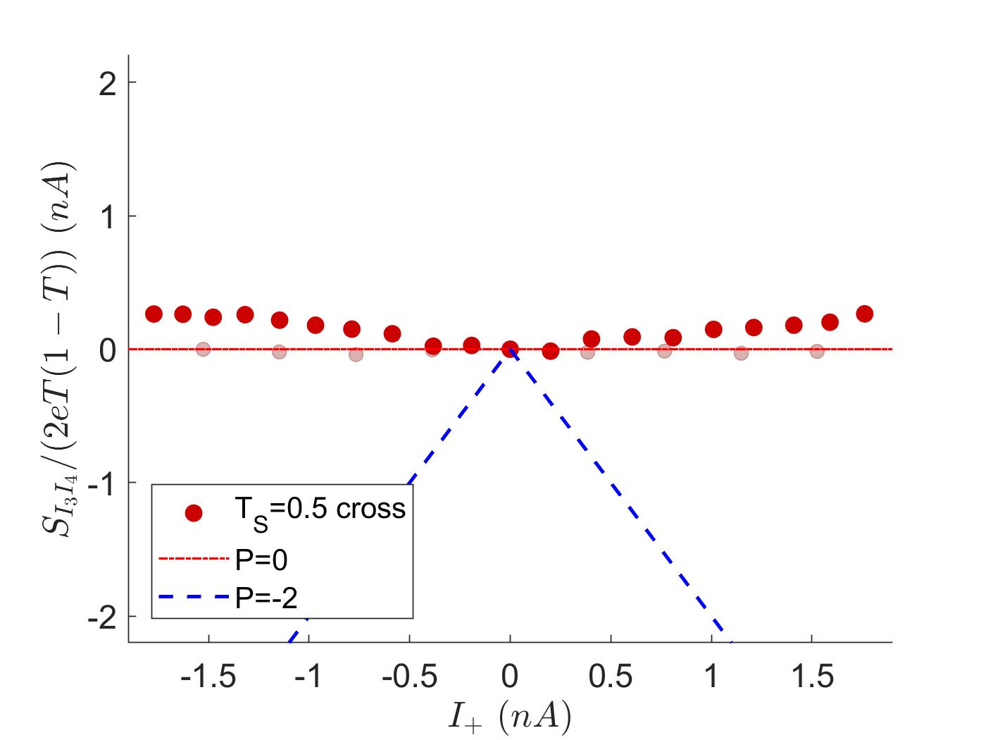
Collisions d’électrons, $ν=2$
Cas entier:
$${ν=2,{T=0.4, T}_{S}=0.5}_{}^{}$$
$${\left\langle ∆I_{3}∆I_{4}\right\rangle }_{n} (nA)$$
$${\left\langle ∆I_{3}∆I_{4}\right\rangle }_{n}=\frac{\left\langle ∆I_{3}∆I_{4}\right\rangle }{2qT(1−T)/T_{meas}}$$
$${\left\langle ∆I_{3}∆I_{4}\right\rangle }_{n}=PI_{+}$$
H. Bartolomei, M. Kumar et al., Science 368 173 (2020)

Slide 24
Collisions d’électrons, $ν=2$
Cas entier:
$${ν=2,{T=0.4, T}_{S}=0.5}_{}^{}$$
$${\left\langle ∆I_{3}∆I_{4}\right\rangle }_{n} (nA)$$
$${\left\langle ∆I_{3}∆I_{4}\right\rangle }_{n}=\frac{\left\langle ∆I_{3}∆I_{4}\right\rangle }{2qT(1−T)/T_{meas}}$$
$${\left\langle ∆I_{3}∆I_{4}\right\rangle }_{n}=PI_{+}$$

Slide 25
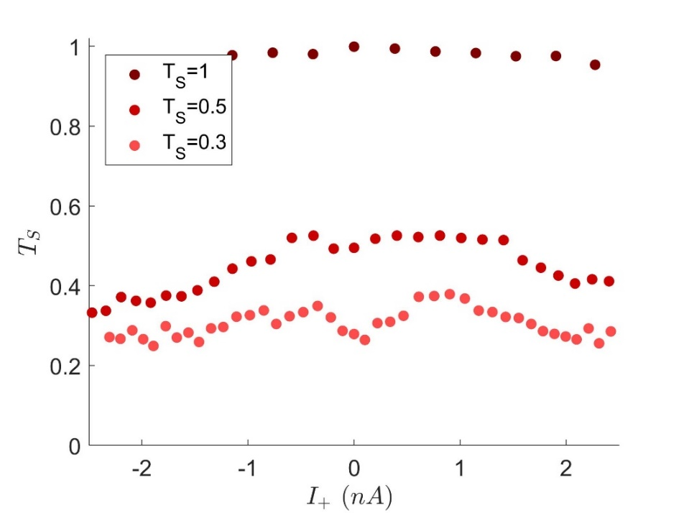
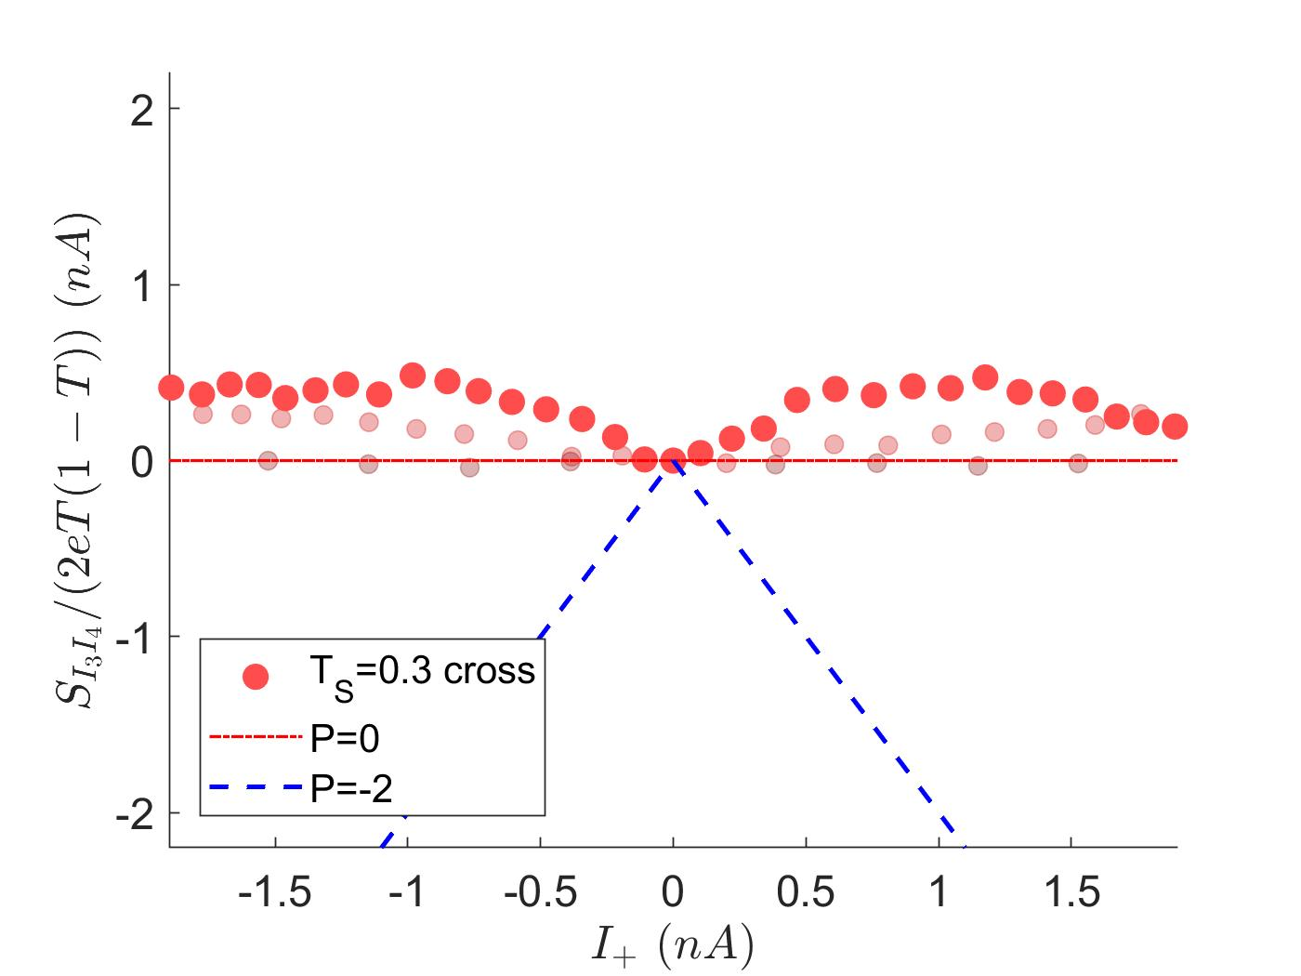
Collisions d’électrons, $ν=2$
Cas entier:
$${ν=2,{T=0.4, T}_{S}=0.5}_{}^{}$$
$${\left\langle ∆I_{3}∆I_{4}\right\rangle }_{n} (nA)$$
$${\left\langle ∆I_{3}∆I_{4}\right\rangle }_{n}=\frac{\left\langle ∆I_{3}∆I_{4}\right\rangle }{2qT(1−T)/T_{meas}}$$
$${\left\langle ∆I_{3}∆I_{4}\right\rangle }_{n}=PI_{+}$$

Slide 26
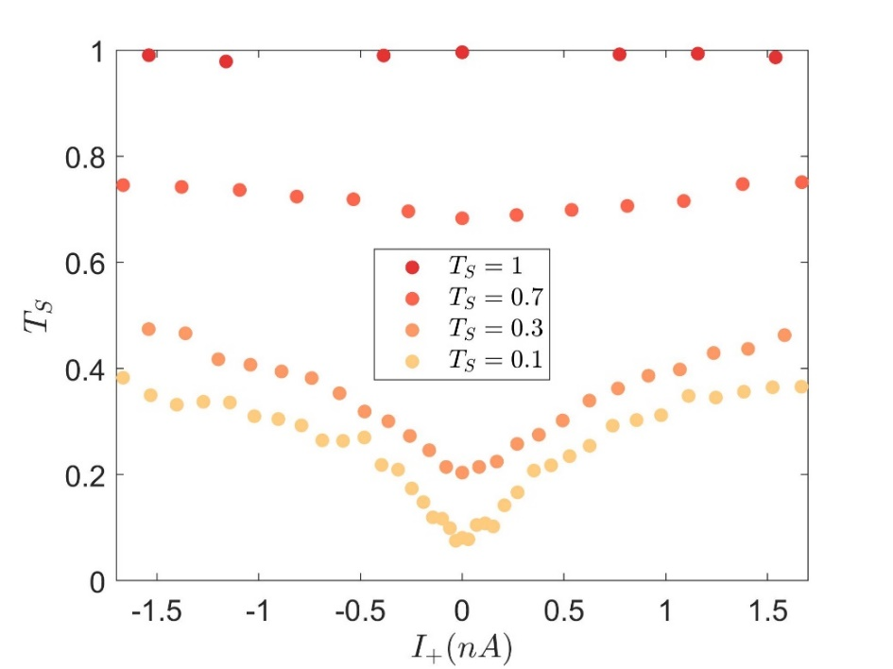
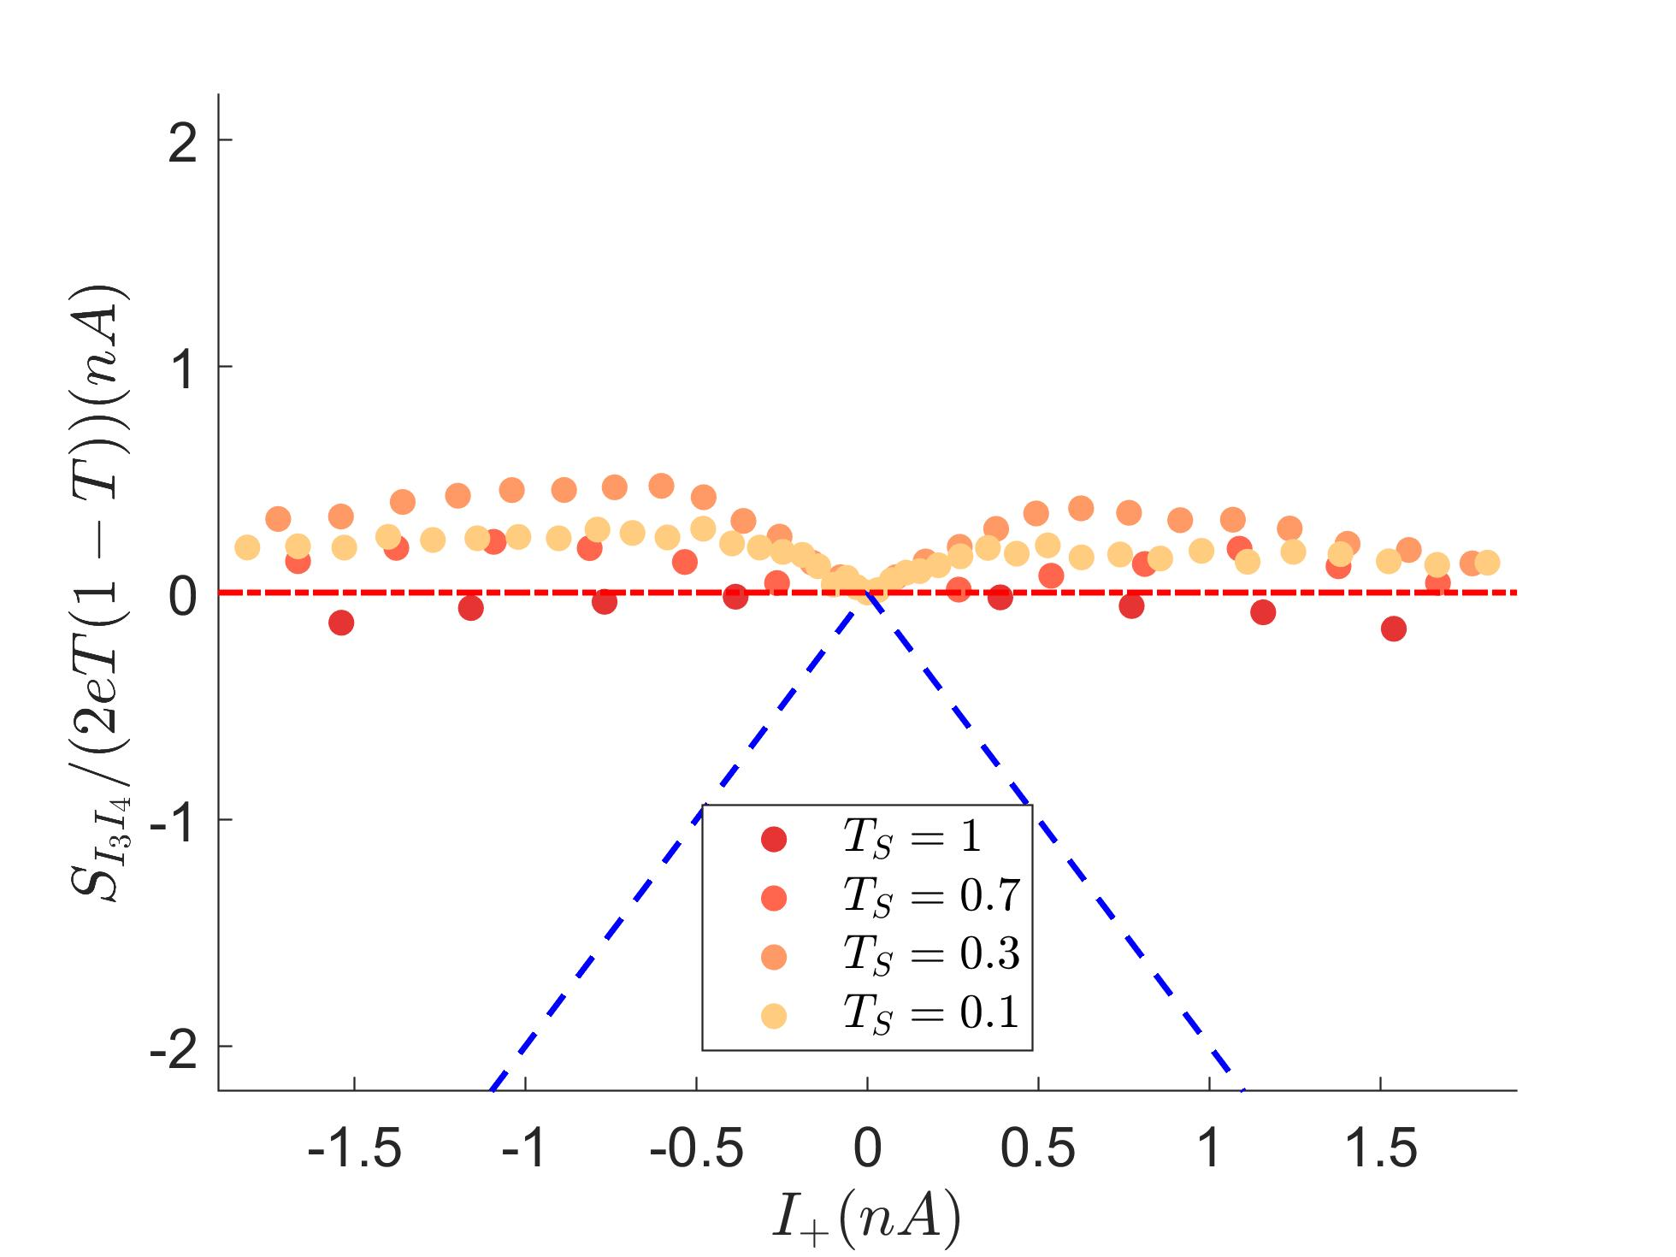

Collisions d’électrons, $ν=3$
Cas entier:
$${ν=3,{T=0.5 }_{}}_{}^{}$$
$${\left\langle ∆I_{3}∆I_{4}\right\rangle }_{n} (nA)$$
$${\left\langle ∆I_{3}∆I_{4}\right\rangle }_{n}=\frac{\left\langle ∆I_{3}∆I_{4}\right\rangle }{2qT(1−T)/T_{meas}}$$
$${\left\langle ∆I_{3}∆I_{4}\right\rangle }_{n}=PI_{+}$$

Slide 27
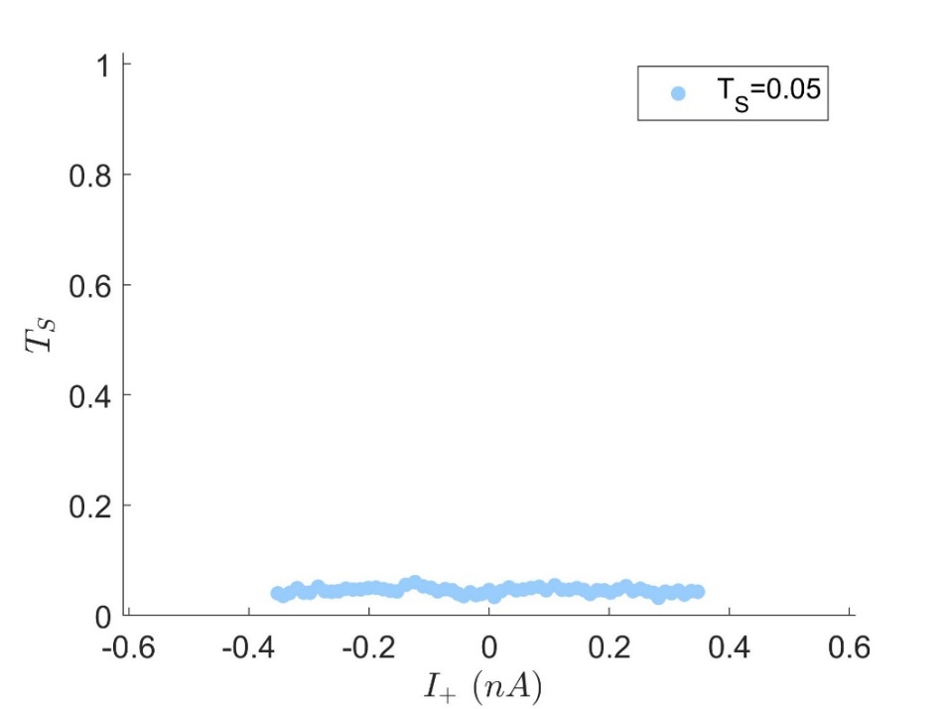
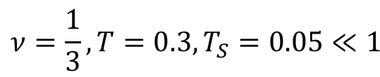
Collisions d’anyons, $ν=1/3$
Cas fractionnaire:
$${ν=\frac{1}{3},{T=0.3, T}_{S}=0.05≪1}_{}^{}$$
H. Bartolomei, M. Kumar et al., Science 368 173 (2020)

Slide 28
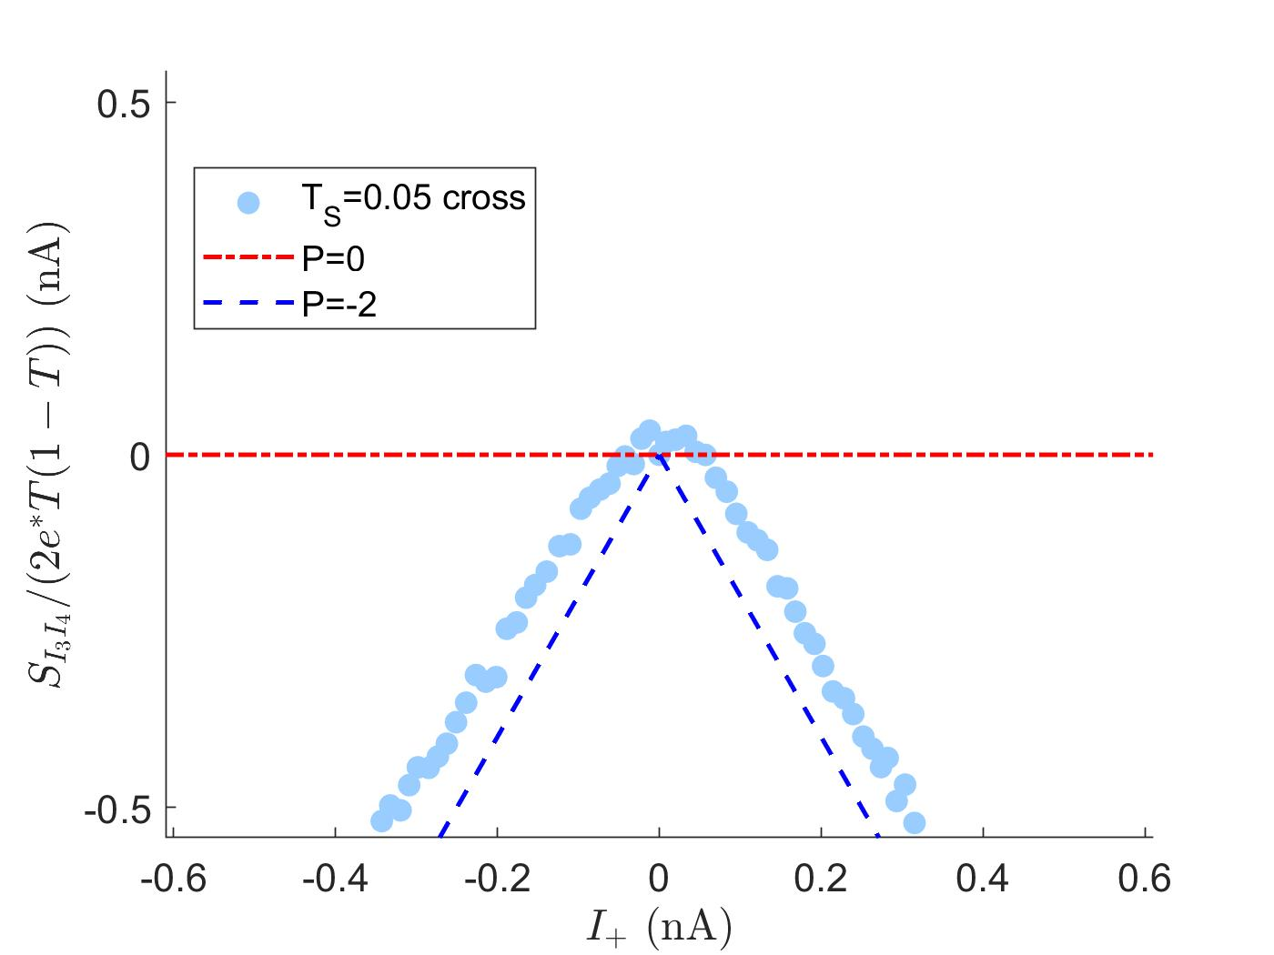


Collisions d’anyons, $ν=1/3$
Cas fractionnaire:
$${ν=\frac{1}{3},{T=0.3, T}_{S}=0.05≪1}_{}^{}$$
$${\left\langle ∆I_{3}∆I_{4}\right\rangle }_{n} (nA)$$
$${\left\langle ∆I_{3}∆I_{4}\right\rangle }_{n}=\frac{\left\langle ∆I_{3}∆I_{4}\right\rangle }{2qT(1−T)/T_{meas}}$$
$$P=−1.9$$
$${\left\langle ∆I_{3}∆I_{4}\right\rangle }_{n}=PI_{+}$$
H. Bartolomei, M. Kumar et al., Science 368 173 (2020)

Slide 29
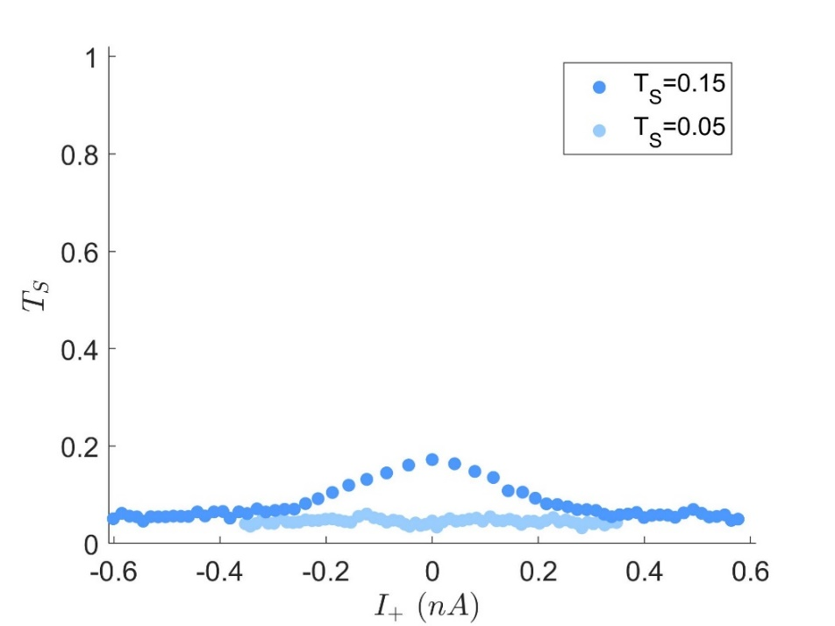




Collisions d’anyons, $ν=1/3$
Cas fractionnaire:
$${ν=\frac{1}{3},{T=0.3, T}_{S}=0.15}_{}^{}$$
$${\left\langle ∆I_{3}∆I_{4}\right\rangle }_{n} (nA)$$
$$P=−1.7$$
$${\left\langle ∆I_{3}∆I_{4}\right\rangle }_{n}=\frac{\left\langle ∆I_{3}∆I_{4}\right\rangle }{2qT(1−T)/T_{meas}}$$
$$P=−1.9$$
$${\left\langle ∆I_{3}∆I_{4}\right\rangle }_{n}=PI_{+}$$
H. Bartolomei, M. Kumar et al., Science 368 173 (2020)

Slide 30







Collisions d’anyons, $ν=1/3$
Cas fractionnaire:
$${ν=\frac{1}{3},{T=0.3, T}_{S}=0.25}_{}^{}$$
$${\left\langle ∆I_{3}∆I_{4}\right\rangle }_{n} (nA)$$
$$P=−1.7$$
$$P=−1.5$$
$${\left\langle ∆I_{3}∆I_{4}\right\rangle }_{n}=\frac{\left\langle ∆I_{3}∆I_{4}\right\rangle }{2qT(1−T)/T_{meas}}$$
$$P=−1.9$$
$${\left\langle ∆I_{3}∆I_{4}\right\rangle }_{n}=PI_{+}$$
$P≈−2$ anyon
H. Bartolomei, M. Kumar et al., Science 368 173 (2020)

Slide 31









Régime de forte rétrodiffusion
Faible rétrodiffusion:
Trasnfert d’anyons
Forte rétrodiffusion:
Transfert d’électrons
$$V_{1}<0$$
$$V_{2}<V_{1}$$
1-T<<1
Laughlin state $ν=1/m$
Electron
T<<1
T~1
$$q=e$$
$$q=e/m$$
$$φ=π$$
$$φ=π/m$$
$$V_{1}<0$$
$$V_{2}<V_{1}$$

Slide 32





Collision d’electrons/anyons à $ν=1/3$
Cas fractionnaire:
$${ν=\frac{1}{3},{T=0.3,T}_{S}=0.7}_{}^{}$$
$${\left\langle ∆I_{3}∆I_{4}\right\rangle }_{n} (nA)$$
Strong backscattering, tunneling charge q=e

Slide 33









Conclusion
Colliders can be used to highlight fermionic/fractional statistics independently of charge
Single QPC autocorrelation shot noise normalized by charge
Collision crosscorrelations normalized by charge
cv
cv
$P=0^{+}$ fermion
$S_{ii}/(2q(T\left(1−T\right)$) (nA)
Charge
$${\left\langle ∆I_{3}∆I_{4}\right\rangle }_{n} (nA)$$
$${\left\langle ∆I_{3}∆I_{3}\right\rangle }_{n} (nA)$$
$S_{34}/(2q(T\left(1−T\right)$) (nA)
Statistics
$P≈−2$ anyon
$$\frac{S_{I_{3}I_{3}}}{2qT\left(1−T\right)}=I_{0}$$
$$\frac{S_{I_{3}I_{4}}}{2qT\left(1−T\right)}=P I_{+}$$
R. de Picciotto et al., Nature 389, 162 (1997).
B. Rosenow, I. Levkivskyi and B. Halperin, PRL 116 156802 (2016)
L. Saminadayar et al., Phys. Rev. Lett. 79, 2526 (1997).
H. Bartolomei, M. Kumar et al., Science 368 173 (2020)
Fractional statistics can also be measured in interferometers (Fabry-Perot)
J. Nakamura, S. Liang, G.C. Gardner, M.J. Manfra, Nature Physics 16 931 (2020).

Slide 34

The collider: sample
Fermions
Anyons

Slide 35








Fractional charges and noise, ν=1/3
$$I_{4}$$
T<<1:quasiparticle transfer is a poissonian process:
$$\left\langle ∆N_{T}^{2}\right\rangle =\left\langle N_{T}\right\rangle =TN_{0}$$
T
$$V$$
$$\left\langle ∆I_{T}^{2}\right\rangle =\frac{q^{2}}{T_{meas}^{2}}\left\langle ∆N_{T}^{2}\right\rangle =\frac{qT}{T_{meas}}\frac{qN_{0}}{T_{meas}}=\frac{qT}{T_{meas}}I_{0}$$
$$I_{0}$$
$$q$$
$$I_{3}$$
$$q=e$$
$$q=e/3$$

Slide 36


Fractional charges and noise, ν=1/3
$$I_{4}$$
T<<1:quasiparticle transfer is a poissonian process:
$$\left\langle ∆N_{T}^{2}\right\rangle =\left\langle N_{T}\right\rangle =TN_{0}$$
T
$$V$$
$$\left\langle ∆I_{T}^{2}\right\rangle =\frac{q^{2}}{T_{meas}^{2}}\left\langle ∆N_{T}^{2}\right\rangle =\frac{qT}{T_{meas}}\frac{qN_{0}}{T_{meas}}=\frac{qT}{T_{meas}}I_{0}$$
$$I_{0}$$
$$q$$
$$I_{3}$$
$$q=e/3$$

Slide 37


Inteférences quantiques de 2 photons
Interférences quantiques
à 2 particules
1
2
1
2
3
4
3
4
1
2
3
4
Photons pairs :
C. Hong et al., PRL 59(18), 2044 (1987)
Different emitters :
J. Beugnon et al., Nature 440, 779 (2006)
P. Maunz et al., Nature Physics 3, 538 (2007)
E. B. Flagg et al., PRL 104, 137401 (2010)

Slide 38










The anyon collider, Rosenow et al.,
Phys. Rev. Lett 116, 156802 (2016)
Chiral Luttinger liquid description:
bosonic fields describe charge fluctuatoins at the input of the collider
$$φ$$
$$\left[φ_{i}(0,t),φ_{j}\left(0,t′\right)\right]=iπδ δ_{ij} sgn(t−t^{′})$$
$$H_{T}=ζe^{iφ_{1}\left(0,t\right)−iφ_{2}\left(0,t\right)}+h.c.$$
Poissonian emission of quasiparticles at inputs 1 and 2:
$$φ_{i}\left(0,t\right)=φ_{i}^{(0)}\left(0,t\right)+2πλ N_{i}(t)$$
$N_{i}\left(t\right):$ random (poissonian) variable, number of quasiparticles emitted in time t
Laughlin case:
$$λ=1/m$$
$$λ$$
but can be renormalized by interactions
$$V_{1}=V_{2}=V_{S}$$
$$T_{1}=T_{2}=T_{S}≪1$$
$$S_{I_{3}I_{4}}=P 2qT I_{+}, P=1−\frac{\tan\left(πλ\right)}{\tan\left(πδ\right)}\frac{1}{1−2δ}=−2 (λ=δ=ν=1/3)$$
$$I_{+}=I_{1}+I_{2}≠0$$
$$I_{−}=I_{1}−I_{2}=0$$

Slide 39







Anyon collisions, $I_{−}≠0$
$${I_{+}=I}_{1}+I_{2}≠0$$
$$T_{1}=T_{2}=T_{S}$$
$$V_{1}≠V_{2}$$
$$P\left(I_{−}/I_{+}\right)$$
$${I_{−}=I}_{1}−I_{2}≠0$$
Very good agreement with predictions for anyon collisions with $φ=\frac{π}{3}$
B. Rosenow et al., Phys. Rev. Lett 116, 156802 (2016)

Slide 40









Conclusion 2: Fabry-Perot experiments
$$V_{p}$$
$$V_{p}$$
$$B$$
$$B$$
C. de C. Chamon, et al., PRB 55, 2331 (1997)
J. Nakamura, S. Liang, G.C. Gardner, M.J. Manfra, Nature Physics 16 931 (2020).
K.T. Law, D.E. Feldman, Y. Gefen, PRB 74, 045319 (2006)
$$θ=2π\frac{q}{h}BA+N_{qp}2φ$$
$$ν=1/3$$
Braiding phase
$$2φ=2π/3$$
AB phase
Important: coulomb interactions can be neglected

Slide 41

Anyon collision : different transmission for cQPC

Slide 42




















Laughlin’s argument for quantized Hall conductance
$$\vec{A}=By\vec{e_{x}}$$
$$y$$
$$V$$
$$H=\sum_{j=1}^{N}{\frac{{(\vec{p_{j}}−e\vec{A}(\vec{r_{j}}))}^{2}}{2m}}+eEy_{j}$$
$$x$$
$$Δy$$
$$y$$
$$0$$
$$ψ_{k,n}(x,y)=e^{ik_{p}x}φ_{n}(y+y_{0}−\frac{ℏk_{p}}{eB})$$
$$y_{0}=\frac{Em}{eB^{2}}$$
$$k_{p}=p\frac{2π}{L_{x}}⟶Δy=\frac{h}{eBL_{x}}$$
$$\vec{A}⟶\vec{A}+A_{0}\vec{e_{x}}$$
$$ψ_{k,n}(x,y)⟶e^{ik_{p}x}φ_{n}(y+y_{0}−\frac{ℏk_{p}}{eB}−α)$$
$$α=\frac{A_{0}}{B}$$
$$Δφ=A_{0}L_{x}$$
wavefunctions shifted to another:
one electron is transferred
For
$α=Δy$, $Δφ=h/e$
$$q=e, G=υ\frac{e^{2}}{h}$$
$$I=\frac{ΔH}{Δφ}=\frac{qVν}{h/e}⟶$$
$$q=e/3, G=\frac{e^{2}}{3h}$$

Slide 43

Looking for neutral modes?

Slide 44





Non-linearities, weak tunneling limit
$${T_{f}=1−T≪1}_{}^{}$$
Weak tunneling limit:
Pinched QPC
$${T_{f}=\frac{∂I_{f}}{∂V}\frac{3h}{e^{2}}∝V^{\frac{2}{δ}−2}}_{}^{}$$
$${3.5≤\frac{2}{δ}−2≤4.5}_{}^{}$$
$${0.36≤δ≤0.31}_{}^{}$$

Slide 45







Non-linearities, weak backscattering limit
Weak backscattering limit:
Open QPC
$$T=1−T_{f}≪1$$
$${\begin{aligned}2δ−2=−0.7 \\ →δ≈2/3\end{aligned}}_{}^{}$$
$${\begin{aligned}2δ−2=−1.3 \\ →δ≈1/3\end{aligned}}_{}^{}$$
$${T_{}=\frac{∂I_{b}}{∂V}\frac{3h}{e^{2}}∝V^{2δ−2}}_{}^{}$$
$${{\tilde{T}}_{}=0.96−T_{f}}_{}^{}$$
$${{\tilde{T}}_{}∝V^{2δ−2}}_{}^{}$$

Slide 46


Non-linearities, weak backscattering limit
Weak backscattering limit:
$$T=1−T_{f}≪1$$
$${T_{}=\frac{∂I_{b}}{∂V}\frac{3h}{e^{2}}∝V^{2δ−2}}_{}^{}$$
$${{\tilde{T}}_{}=0.942−T_{f}}_{}^{}$$
$${{\tilde{T}}_{}∝V^{2δ−2}}_{}^{}$$

Slide 47

Temperature dependence

Slide 48

The collider: sample

